Slide 1
GDP Group 18
Unmanned Aircraft Camera Module
Notes:
Michael Start
Welcome

Slide 2
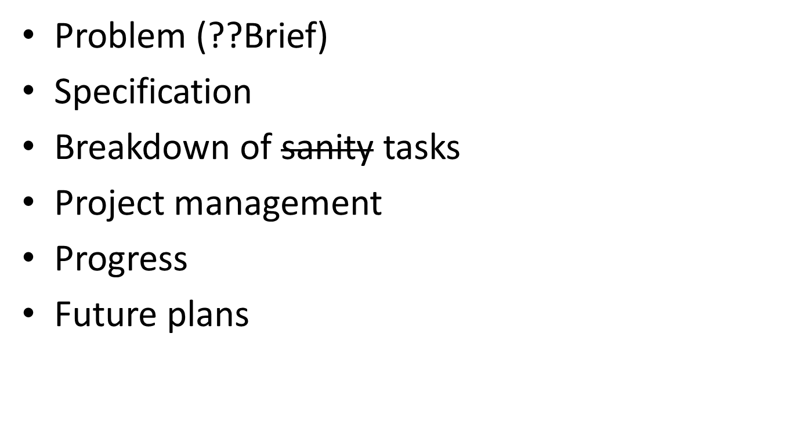
The Next 20 Minutes
Notes:
Michael
Describe our project: problem, specification, etc
How we’ve managed the project so far
Progress
Future plans

Slide 3
Problem
Notes:
Michael

Slide 4
Problem
Currently, autopiloted UAV must land before images can be viewed
Images could be inadequate
Wireless transmission of images preferred
Notes:
Michael

Slide 5
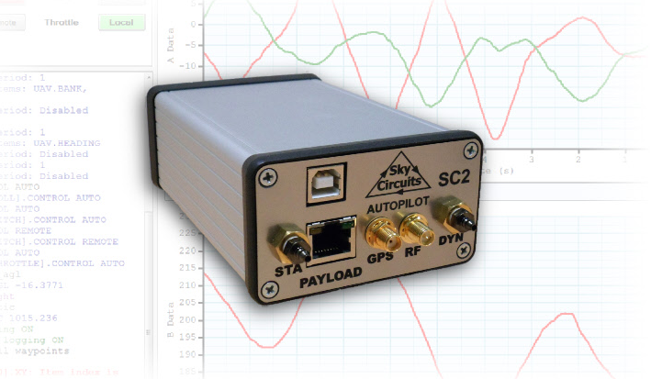
SkyCircuits Autopilot (SC2)
http://www.skycircuits.com/
Notes:
Michael

Slide 6
Specification
Notes:
John

Slide 7
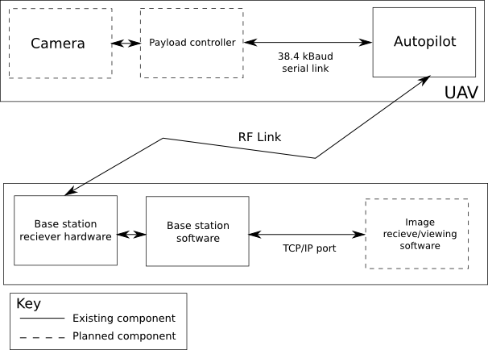
Specification
Notes:
John“To design, build and test an electronic module capable of capturing still images from an unmanned aerial vehicle (UAV) and transmitting the images to a base station. The module must use the UAV autopilot’s low-bandwidth RS485 serial link (38.4 kBaud). A program must be written to interface with the base station software over a TCP/IP link, allowing image data to be received and displayed to the user. The electronic module will be constructed using strip-boards and will later be implemented on PCB if time is available.

Slide 8
Spec: High Priority
Prompt (from base station) to capture and download image
Image encoding
Minimise download time (less than 3 minutes)
Notes:
John

Slide 9
Spec: Medium Priority
Module weight < 250g
Image resolution: 640 x 480
Cancel image download whilst downloading
Notes:
John

Slide 10
Spec: Low Priority
Resend an image if corrupted
Interrupt download of image, save incomplete image
Select resolution of image
Display progress indicator of download
(User defined) Automatic image capture
Colour images (select between colour / BW)
Notes:
John

Slide 11
Spec: Deliverables
Hardware: Constructed camera module (on PCB if possible)
Software: Firmware for module, Software for base station
Documentation: Technical and User Documentation
Public Repository: Open source, publically accessible repository, includes all the above.
Notes:
John

Slide 12
Breakdown of Tasks
Notes:
Andy

Slide 13
System Block Diagram
Notes:
andy

Slide 14
Breakdown of Tasks: UAV Payload
Acquire Components
Camera Module Communication
Image Encoding/Transmission
  Basic Raw Encoding (JPEG?)
  Custom (compressed) encoding
Payload Module Construction
Notes:
andy

Slide 15
Breakdown of Tasks: Base Station
TCP/IP Base Station Communications
Decode Image (Custom decoding)
User Interface
Notes:
Andy

Slide 16
Breakdown of Tasks:
Complete System
Background Research
UAV module / Base station Integration
Whole System Testing
Delicious Report Writing.
Notes:
Andy

Slide 17
Project Management
Notes:
Mitch:
Manage the human resources available and how best to utilise them.
Pre-emptive steps to take care of problems that might arise: always know what we’re doing
Manage time resource and measure the progress of the project, so we can adapt quickly if behind.

Slide 18
Project Management: Skills Audit
Andy: Power, PCB, Control, MATLAB
Mitch: Image Processing, MATLAB, ASM, Report Writing
John: MATLAB, Image Processing, Control, Radio Transmission
Peak: Digital Control, Display, MATLAB, Information Theory
Michael: Programming, uProcessors, Interfaces
Notes:
Mitch
Pass quickly.
* Includes modules done, skills built up individually, etc.

Slide 19
Project Management: Contingencies + Risk Management
Risk | Likelihood (1: Low, 5: High) | Impact (1: Low, 5: High) | Action
Faulty Components | 4 | 4 | Order spares where feasible. Source new/replace faulty components at high speed otherwise.
Team member becoming unavailable | 2 | 4 | At least two people on each task. Reallocating people to different tasks as required
Team member facing difficulties | 5 | 2 | At least two people per task. Good team communication. Prioritise necessary tasks first.
Notes:
Mitch
Why? Problems will arise. Need an appropriate plan for any problem that may occur as to not waste any time resource.
FC:
L4: experience with providers, general short circuits, loss, etc. (many factors)
I4: Project hardware dependent. Very real and serious problem.
Very time consuming problem (delivery, many other parts depend on this).
Team:
L2: Southampton is a safe place. Members take care of themselves.
I4: Each person is 20% of primary resource (needed to get things done)
All tasks can be done by different people, so catching up is easy.
Difficulties:
L5: Very challenging project ranging from hardware to software difficulties.
I2: Expected. Does not directly slow down progress.
Teamwork is more efficient than lone work

Slide 20
Project Management: Contingencies + Risk Management
Risk | Likelihood (1: Low, 5: High) | Impact (1: Low, 5: High) | Action
Task overrunning | 4 | 3 | Plenty of redundancy planned into Gantt Chart. Reallocation of resources when necessary. Good team communication.
Loss of files/source code | 1 | 5 | Proper use of source control. Back ups.
Notes:
Mitch
Risk
L4: Impossible to always know what other is doing without consistent, non-stop (unrealistic) communication.
I3: Results in wasted time and man resource, slowing project down until progress is reassessed.
Action: Reassess regularly
Loss
L1: Many countermeasures available. Very rare occurrence.
I5: Project relies a lot on software (git/svn).

Slide 21
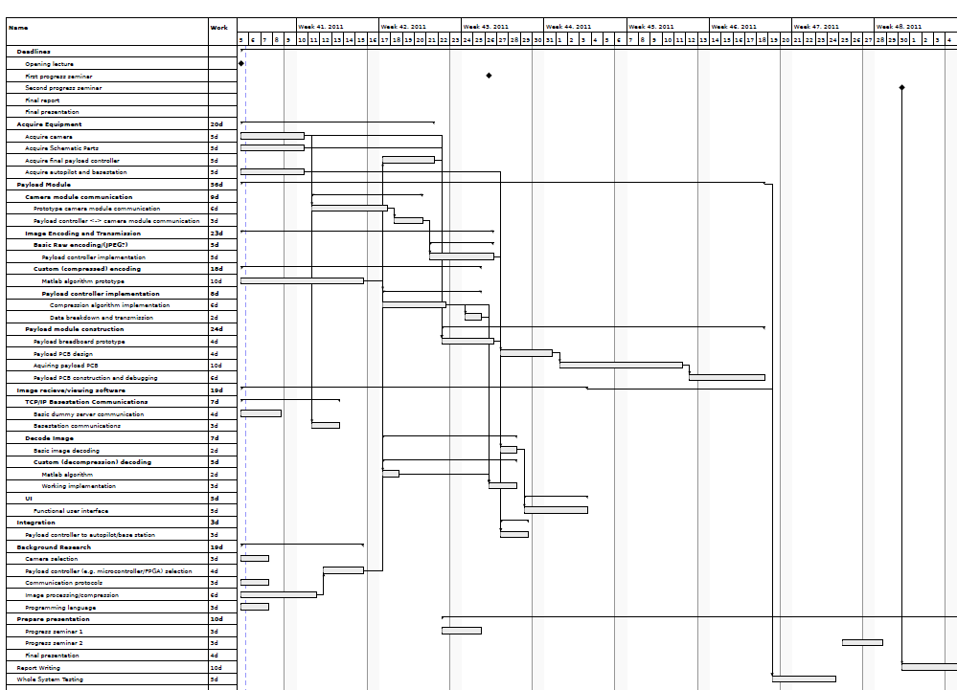
Project Management
Notes:
Mitch
Initial Gantt chart.
We will summarise some of the main points of our Gantt chart in the next few slides.

Slide 22
Progress
Notes:
Peak

Slide 23
Progress : Acquire Equipment
Task | Planned Start – End | Current Status | Person(s) Responsible
Acquire camera | 5/10/11 – 10/10/11 | Camera faulty, seeking replacement, exploring other cameras | John, Michael
Acquire Dummy payload schematic parts | 5/10/11 – 10/10/11 | Completed on 18/10/11 – Delay with requisition system | John, Andy
Acquire final payload microcontroller | 17/10/11 – 21/10/11 | Not completed, dependant on image encoding methods | Andy, Peak
Acquire autopilot and basestation | 5/10/11 – 10/10/11 | Received on 12/10/10 from customer | Andy, Peak
Notes:
Peak

Slide 24
Progress: Payload Module
Task | Planned Start – End | Current Status | Person(s) Responsible
Prototype camera module communication | 11/10/11 – 17/10/11 | Camera faulty, seeking replacement, exploring other cameras | John, Michael
Payload controller to camera module communication | 18/10/11 – 20/10/11 | Not completed, dependant on above task. | John, Michael
Raw image encoding payload controller implementation | 21/10/11 – 26/10/11 | Not completed, dependant on above task. | Andy, Peak
Custom (compressed) encoding | 5/10/11 – 25/10/11 | MATLAB algorithms implemented | John, Mitch, Andy, Peak, Michael
Notes:
Peak
Custom (compressed) encoding:
Split up into number of subtasks

Slide 25
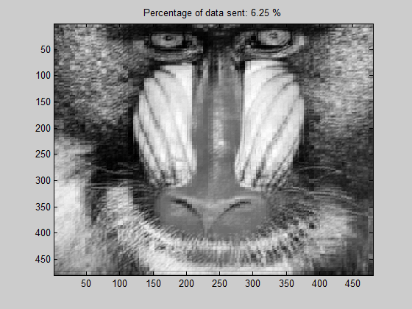

Slide 26
Progress: Ground Station
Task | Planned Start – End | Current Status | Person(s) Responsible
TCP/IP basic dummy server communications | 5/10/11 – 8/10/11 | Receiving data from autopilot via ground station TCP/IP link | Andy, Peak
Communications from base station to autopilot payload | 11/10/11 – 13/10/11 | Not completed, requires construction of dummy payload module | Andy, Peak
Notes:
Peak
Custom (compressed) encoding:
Split up into number of subtasks

Slide 27
Future Plans
Notes:
Michael

Slide 28
Future Plans
Get a working camera.
Get a working dummy payload.
Translate compression algorithms to C.
Test raw image transmission.
Notes:
Michael

